Slide 1
Future Directions for Formal Science Education
National COSEE Network Meeting
Arthur Eisenkraft, UMass Boston

Slide 2
Perspectives from an Outsider/Insider
No Ocean Science background
Contributed to the following documents
National Science Education Standards
National Assessment of Educational Progress (NAEP) – 2009-2019
College Board Science Standards for College Success
National Research Council – Frameworks for the new Common Core
Curriculum developer
Active Physics
Active Chemistry

Slide 3
Where is the Ocean Science?
Logical place in Standards and Frameworks
Physical Science
Life Science
Earth and Space Science
In Formal Curriculum
Physics
Chemistry
Life Science
Earth science

Slide 4
National Science Education Standards
On PAGE 159 ..., chemical, and biological processes act within and among the four components on a wide range of time scales to change continuously earth's crust, oceans, atmosphere, and living organisms. Students can investigate the water and rock cycles as introductory examples of geophysical and geochemical cycles....
On PAGE 159 ... plates that move without deforming, except at boundaries where they collide. Those plates range in thickness from a few to more than 100 kilometers. Ocean floors are the tops of thin oceanic plates that spread outward from midocean rift zones; land surfaces are the tops of thicker, less-dense ...
At the top of PAGE 160 ... Lithospheric plates on the scales of continents and oceans constantly move at rates of centimeters per year in response to movements in the mantle. Major geological events, such as earthquakes, volcanic ...

Slide 5
National Science Education Standards
On PAGE 160 ... Water, which covers the majority of the earth's surface, circulates through the crust, oceans, and atmosphere in what is known as the "water cycle." Water evaporates from the earth's surface, rises and cools as it moves to higher elevations, ... as rain or snow, and falls to the surface where it collects in lakes, oceans, soil, and in rocks underground....
On PAGE 160 ... Water is a solvent. As it passes through the water cycle it dissolves minerals and gases and carries them to the oceans....
On PAGE 160 ... Global patterns of atmospheric movement influence local weather. Oceans have a major effect on climate, because water in the oceans holds a large amount of heat....

Slide 6
National Science Education Standards
At the top of PAGE 161 ... The sun is the major source of energy for phenomena on the earth's surface, such as growth of plants, winds, ocean currents, and the water cycle. Seasons result from variations in the amount of the sun's energy hitting the surface, due to the tilt of the earth's ...
At the bottom of PAGE 167 ... students in grades 5-8 have some awareness of global issues, teachers should challenge misconceptions, such as anything natural is not a pollutant, oceans are limitless resources, and humans are indestructible as a species....
At the bottom of PAGE 167 ... rain or global ozone depletion. However, teachers should challenge several important misconceptions, such as anything natural is not a pollutant, oceans are limitless resources, and humans are indestructible as a species....

Slide 7
National Science Education Standards
On PAGE 189 ... Heating of earth's surface and atmosphere by the sun drives convection within the atmosphere and oceans, producing winds and ocean currents....
On PAGE 189 ... is influenced by dynamic processes such as cloud cover and the earth's rotation, and static conditions such as the position of mountain ranges and oceans....

Slide 8
Consistent with Ocean Literacy

Slide 9
Consistent with Scope and Sequence
Introduction to Conceptual Flow Diagrams: Ocean Literacy Scope and Sequence
The Ocean Literacy Scope and Sequence is comprised of 28 conceptual flow diagrams (hereafter referred to as flows). There is one flow for each principle for each grade band (K-2, 3-5, 6-8, and 9-12). Each flow represents one possible way of breaking down and organizing the major concepts and supporting ideas for each principle for a grade band. They can be used as a suggested instructional sequence, organizer of ideas, and/or indicator of learning progression.

Slide 10
From Frameworks to Classroom
Which content is worth teaching?
At what grain size?
Filters that everybody can use
Cost/benefit
Cost = time to learn the concept
Benefit = value and multiplicity of references to this topic

Slide 11
BENEFIT
High | Reflection of light |  | Conservation of energy
Medium
Low | Specific heat of Al = 0.9 J/g ºC |  | Planck’s blackbody radiation
COST | Low | Medium | High

Slide 12
Quality teaching
Can we get teachers to reflect on their own teaching – metacognition?
Can we get teachers to listen intently to what students are saying?
Can we improve formative assessment?
Dipsticking – hands, red/yellow/green cards, clickers
Checking for understanding

Slide 13
Quality teaching Do we agree on what it looks like?
Need for videos
Examples
Exemplars
Varied teaching styles
Varied student populations
That’s not my class! If I had those students…
Can they see what is there?
Need for rubrics for evaluation and self-evaluation. How will I be judged?
Problems with self-reported data

Slide 14
Quality teaching Do we agree on what it looks like?
Instructional model

Slide 15
7E instructional model
Evaluate
Enhancing the 5E model:
The Science Teacher (9/03)
Available at www.cosmic.umb.edu
Engage
Elicit
Explore
Explain
Elaborate
Extend

Slide 16
Quality teaching Do we agree on what it looks like?
Instructional model
Assessment model

Slide 17
4Q Assessment model
What does it mean?
How do we know?
Why do we believe?
Why should I care?
Couple this with emphasis
Big ideas
Organizing principles
Common themes
Align exams to test
What is important
What we value

Slide 18
Quality teaching Do we agree on what it looks like?
Instructional model
Assessment model
Curriculum model

Slide 19
Curriculum Design Model
Understanding by Design
What’s the big idea?
What evidence will I accept that you know this idea?
Assessment triangle
How do I develop curriculum to get you to this understanding
Misconceptions
Prior understandings
What engages students
Inquiry
Equity

Slide 20
How People Learn – Eliciting prior understandings

Slide 21
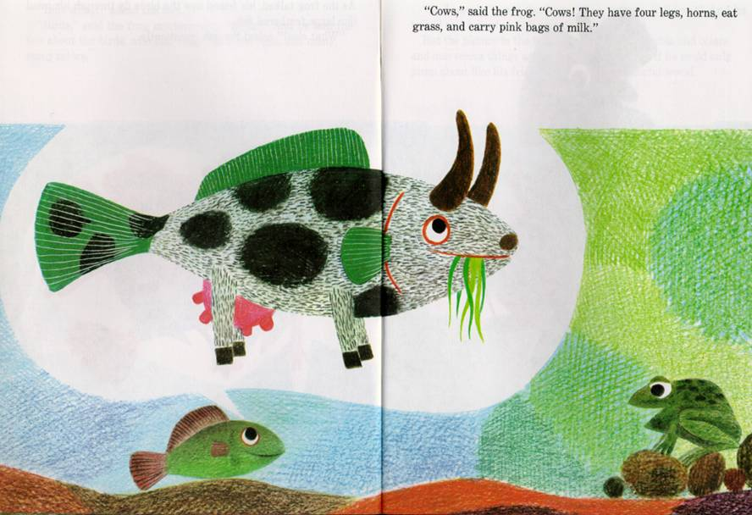

Slide 22
Quality teaching Do we agree on what it looks like?
Instructional model
Assessment model
Curriculum model

Slide 23
Professional Development for Active Physics
Expectation
How People Learn research
Instructional models – 7E model
Inquiry
What engages students intellectually
Equity issues
Problem based learning models
National Science Education Standards

Slide 24
Professional Development for Active Physics
What we find
Content needs: they don’t know enough physics
And then when we visit the class, we find they need
Class management
Checking for understanding (formative assessment)
Transitions
Attention moves

Slide 25
The complexity of teaching
We would like Malevich

Slide 26
The complexity of teaching
We would like Malevich
We can handle Mondrian

Slide 27
The complexity of teaching
We would like Malevich
We can handle Mondrian
We are faced with Pollack

Slide 28
How do we make sense of the complexity w/t pd
Content knowledge
Pedagogical knowledge
Pedagogical content knowledge

Slide 29
Our Basic Premise
Better teaching will yield:
Increased student achievement
Increased student attitudes
More teacher retention
More understanding of better teaching
MISE data and BSP data: after three years of pd, students of those teachers outperformed others.

Slide 30
And what are their needs
Where are they now?
Where would they like to be?
X O
Inquiry
X O
Student misconceptions

Slide 31
Beliefs and Practice
Differentiated instruction
Equity
Cooperative learning
Rubrics
Communities of learners
Inquiry

Slide 32
And, once again, we are confronted with elegant, beautiful and difficult to understand complexity.
What will teachers need?
What do teachers think they need?
How do we assist them?
How do we insure that it is a value added rather than another responsibility?

Slide 33
Our Assumptions
We know the content
We know the grain size of the content
We know how to teach it well
We know how to provide the professional development
Problem: How do we get into the classrooms?

Slide 34
My content is most important
Earth Science is the poor relation w/t bio, physics, chemistry
Ocean Science is the poor relation within ES
Physics
Heat: Laws of thermodynamics
Optics: Lenses, mirrors
Solid state: transistors
Nano sciences
Engineering

Slide 35
Two opportunities “low hanging fruit”
Just-in-time curriculum
Relations to other disciplines

Slide 36
Just-in-time curriculum
Tsunami
Hurricane
Flooding in Bangla Desh
Oil spills

Slide 37
Just-in-time curriculum
Can you link the content to science
That has been taught
That will be taught

Slide 38
Time for content
Elementary school
Can we get more than ½ hour of science per week
Middle school and high school
Three week unit
@ 40 minutes/day = 600 minutes
Not going to happen
Once a week
@15 minutes/week for 40 weeks = 600 minutes
Possible

Slide 39
Relations to other disciplines
Waves
Biology:
Chemistry:
Earth Science: Water waves play an important role is shaping land masses. Like all waves, water waves carry energy. The energy can be used to break up rocks, move sand around, and redefine the contours of beaches and inlets.
Vibrating Strings
Biology:
Chemistry:
Earth Science: Standing waves similar to those set up in vibrating strings can occur in the ground when the soil is saturated with water during an earthquake. This phenomenon increases the destructive power of the earthquake.
Math
Globe – statistics – ocean: LHS curriculum

Slide 40
Reform
“Reform, reform, don’t speak to me of reform. We have enough problems already.”
- Lord Thomas Macaulay
(19th century British politician)

